Slide 1

Arabic Dialects Classification
A Text Classification task
Omneya Essam Kamal
https://github.com/OmneyaEssam/Arabic-Dialects-Classification

Slide 2
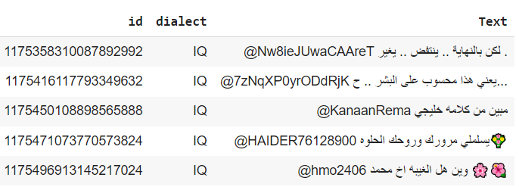
Problem statement
Many countries speak Arabic; however, each country has its own dialect, the aim of this task is to build a model that predicts the dialect given the text.
What does the data look like ?

Slide 3
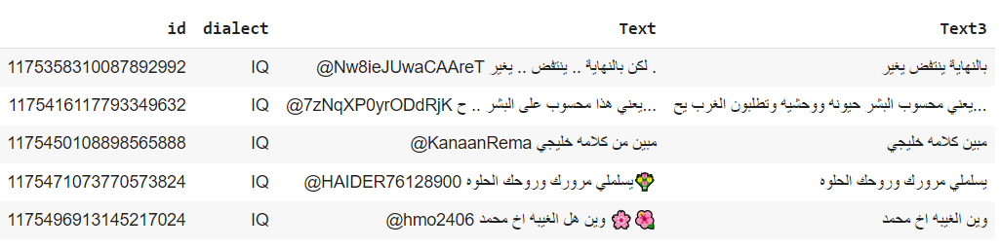
Data preprocessing
Steps:
1- remove emojis
2- remove usernames/handlers
3- remove all http links
4- remove all non Arabic characters
5- remove repeated letters
6- remove stopwords

Slide 4
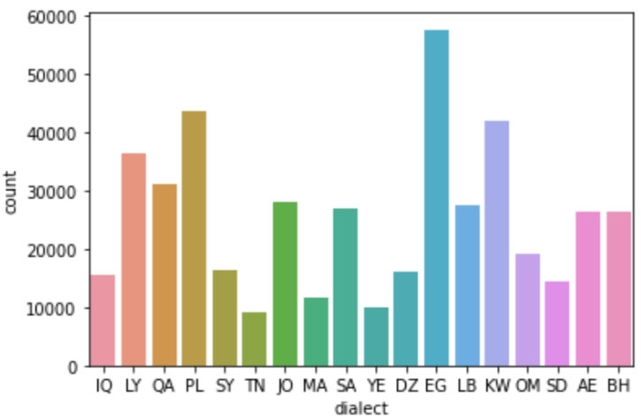

Machine learning model: Naïve Bayes
A- use SMOTE to solve data imbalance problem
B- use TFIDF vectorizer as we need to extract
special words for each dialects
Results

Slide 5
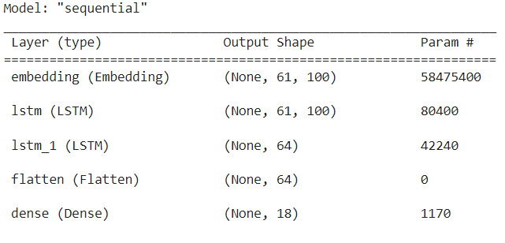
Deep learning model: LSTM model
A- using Aravec word embedding
Results: train accuracy -> 52.8%
val accuracy -> 45.6%

Slide 6
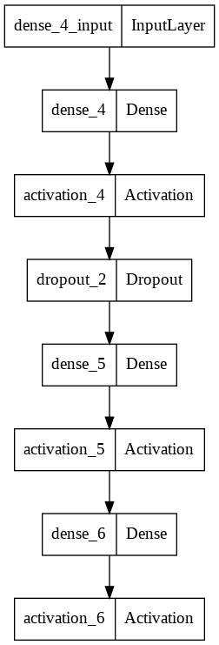
Deep learning model: NN model
A- using TFIDF word vectorizer
Results: train accuracy -> 51.4%
val accuracy -> 46.5%

Slide 7
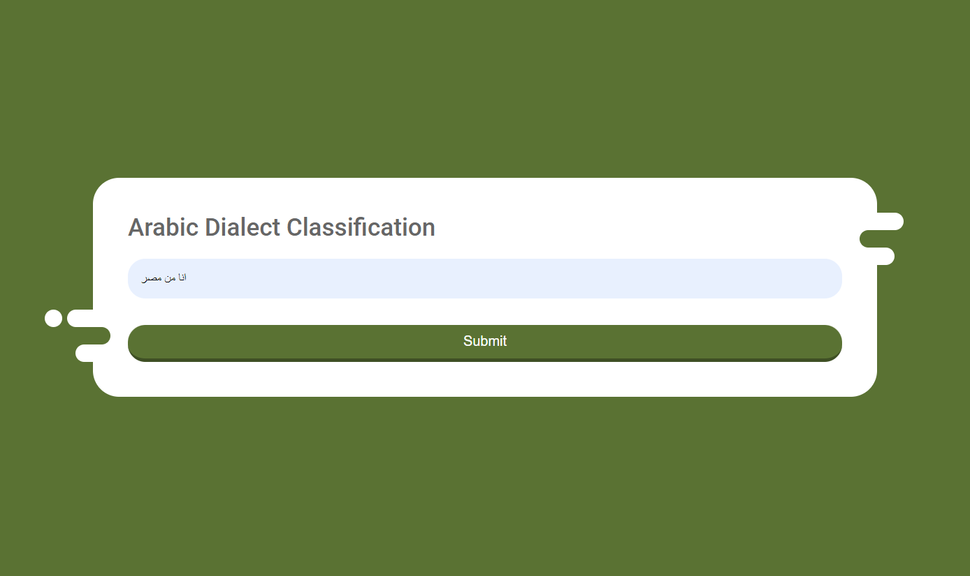
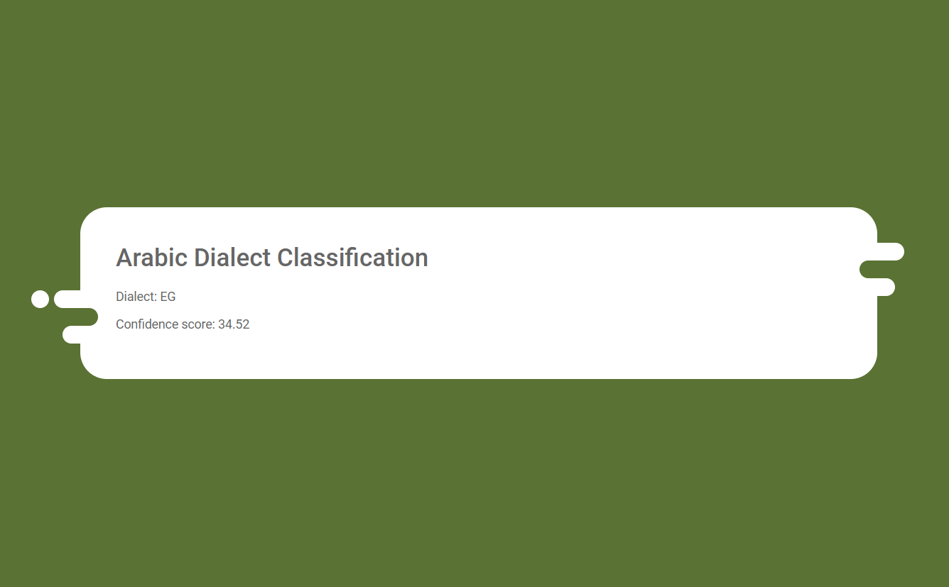
Flask API

